Slide 1

Predictive Modeling of New User Bookings
Nick Kessler

Slide 2
Problem Background
Airbnb users provide numerous data points about themselves when signing up
This information is collected both actively and passively
Active: Age, Gender, Language Preference, Location
Passive: Browser, OS, Device Type, Device Language
Can this information be used to predict where a user will choose to book their first trip using Airbnb’s service?

Slide 3
Data

Slide 4
Data Information
Data provided by Airbnb as part of Kaggle competition
Two datasets:
User data (demographic and signup device information)
User data includes information for users who signed up between 2010-2014
Session Data (web session logs)
Only available for users who signed up after 1-Jan-2014
Data is mostly categorical

Slide 5
User Data
Column | Type | Description
id | String | User identifier.
date_account_created | Date | Date of account creation.
timestamp_first_active | String | Timestamp of first activity. This can occur before account creation as users can browse the site before signing up. Stored as a string value in the dataset.
date_first_booking | Date | Date of first booking. This value is null if the user never booked a trip.
gender | Categorical | User supplied gender. Male, Female, Other or Unknown.
age | Numeric | User supplied age value.
signup_method | Categorical | User signup method. Indicates whether the user created a direct Airbnb account, or signed up with their Facebook or Google account.
language | Categorical | User language preference
affiliate_channel | Categorical | Type of paid marketing, if applicable.
affiliate_provider | Categorical | Where marketing came from. E.g. Google, craigslist, etc.
first_affiliate_tracked | Categorical | First marketing the user interacted with prior to sign up.
signup_app | Categorical | The app the user used to sign up. E.g. Web, iOS, Android.
first_device_type | Categorical | The device type used to sign up. E.g. Windows PC, Mac, iPhone.
first_browser | Categorical | Web browser used to sign up, if applicable
country_destination | Categorical | The destination chosen by the user for their first booking. This is the target variable in this analysis.

Slide 6
Session Data
Column | Type | Description
user_id | String | User identifier. Corresponds to id column in User dataset.
action | Categorical | Description of the action
action_type | Categorical | Action category
action_detail | Categorical | Detailed action description
device_type | Categorical | Type of device (e.g. Windows Desktop, Mac, iPhone)
secs_elapsed | Numeric | Number of seconds elapsed in session.

Slide 7
Target Categories
Country Labels | Full Country Name
AU | Australia
CA | Canada
DE | Germany
ES | Spain
FR | France
GB | United Kingdom
IT | Italy
NL | Netherlands
PT | Portugal
US | United States
NDF | No Destination Found (i.e. None)
other | Other
Twelve possible target values

Slide 8
Data Cleaning & Preparation
User Data
Data was largely pre-processed and clean
Timestamp values converted from string to datetime datatypes
Missing values for Gender were substituted with ‘UNKNOWN’
Certain Age values were entered as birthyear, and were adjusted to age by subtracting birth year value from current year
Missing Age values substituted with 0
Additional derived features engineered from provided data.

Slide 9
Data Cleaning & Preparation
User Data – Derived Features
Column | Type | Description
age_group | Categorical | Derived from Age value. Six age-range group.
days_to_book | Numeric | Difference in days between account creation and date of first booking (if applicable).
device_class | Categorical | Derived from Device Type, simplifies devices into four classes: PC, Tablet, Phone, or Other
affiliate_provider_type | Categorical | Derived from Affiliate Provider, groups providers into four classes: Search, Social, Direct, and Other

Slide 10
Data Cleaning & Preparation
Session Data
Data contains web logs showing each action grouped by category.
To join with user data, session data needed to be reduced to a single row for each user ID
Counts of each action type were compiled for each user ID, creating a dataset that contains the total number of actions in each category initiated by the user.
Seconds Elapsed was summed for each user ID to create a total value.

Slide 11
Exploratory Data Analysis

Slide 12
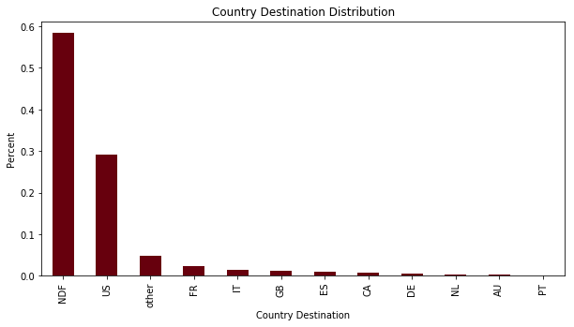
Distribution of Destinations
Majority of users who signed up did not book a trip (NDF)
US is most popular destination
Other is more popular than all non-US top destinations
NDF, US, and other comprise 92% of the total data.

Slide 13
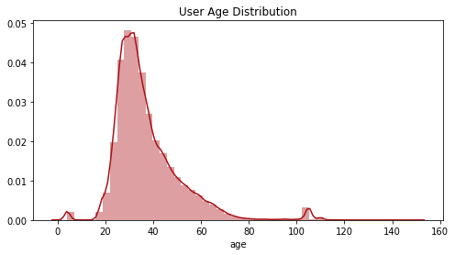
Distribution of Ages
Age distribution shows most users clustered in 20-60 range
Density Plot reveals small number of extreme outliers which are likely errant entries

Slide 14
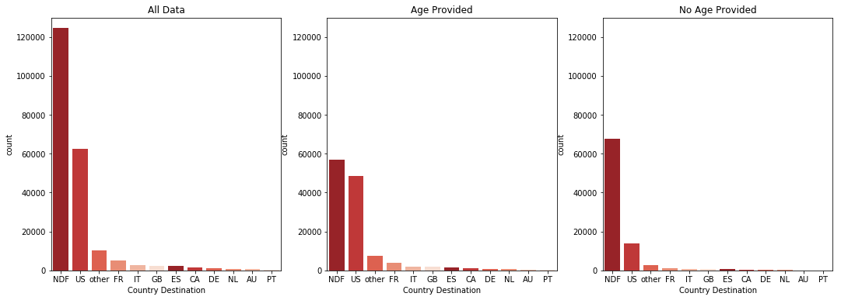
Bookings by Age Provided
Age is an optional user-provided data point
Users who supplied an age were significantly more likely to book a trip than those that did not (Destination of NDF indicates no trip booked)

Slide 15
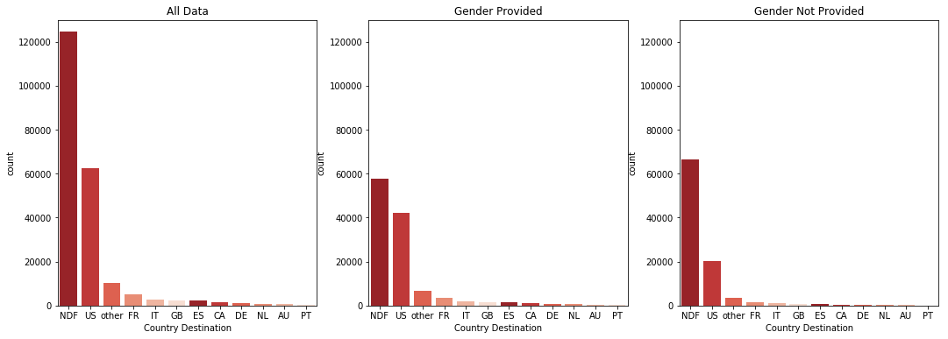
Bookings by Gender Provided
Gender, like Age, is an optional value when signing up
Users who supplied an gender were significantly more likely to book a trip than those that did not.
Conclusion: Users who supplied more information about themselves during signup were far more likely to book.

Slide 16
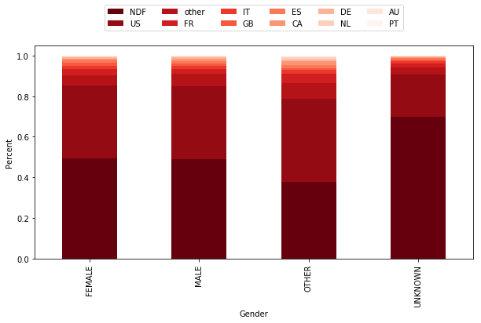
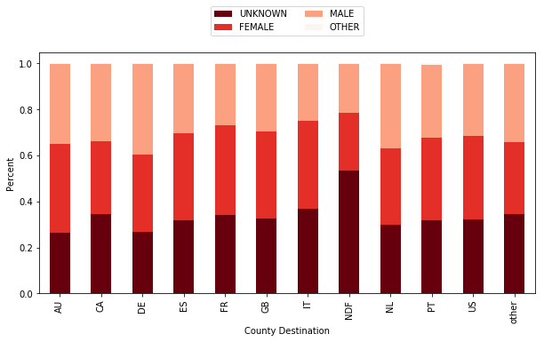
Destination By Gender
Male and Female have very similar preferences for destination countries
Other slightly more likely to book, but represent very small portion of the data
Unsupplied gender associated with NDF

Slide 17
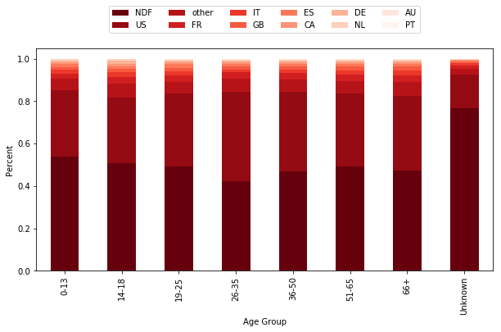
Destination By Age Group
Decision to book or not is similar across age groups, though we see that users in the 26-35 age group were somewhat more likely than others to book a trip after signing up.
Unsupplied Age associated with NDF

Slide 18
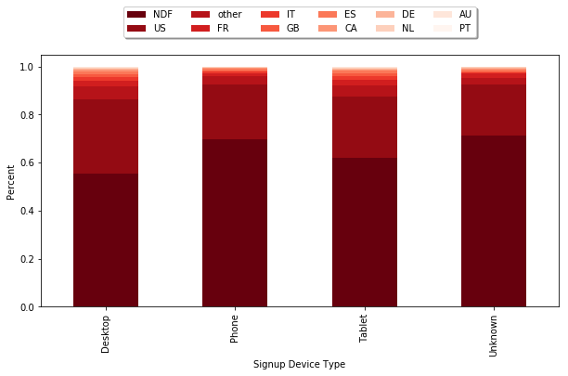
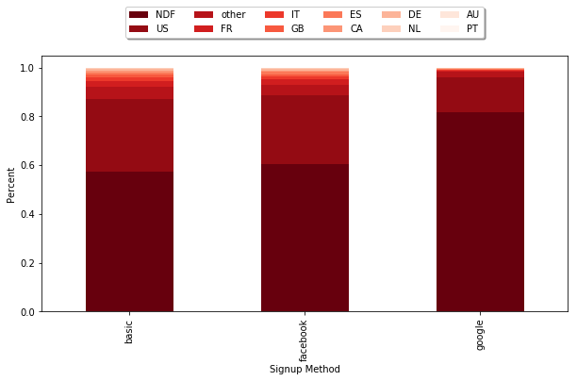
Destination By Signup Method
Users who signed up using a PC or Tablet were significantly more likely to book a trip than phone signups.
Users who signed up with their Google account were significantly less likely to book than those who signed in with Facebook or a direct Airbnb account

Slide 19
EDA - Conclusions
More data supplied → more likely to book
Users who provided Gender or Age information during signup were significantly more likely to book.
Indicates users more serious about booking were more likely to supply this information.
Encouraging users to supply demographic info like Age and Gender during signup may lead to increased bookings following signup
Men and women have similar preferences across all age groups.
Some minor differences. Men slightly more likely than women to book to ‘other’ destinations.
PC & Tablet Users → more likely to book
Users who signed up on PCs or Tablets were far more likely to book a trip than phone users.
Phone users might be more inclined to browse and are less serious about booking.
Mobile web designers may want to find ways to encourage phone users to book.
Make mobile signup and booking simpler
Display listings in a way that encourages booking

Slide 20
Classification Analysis

Slide 21
Twelve Category Classification
Results Summary
All classification models attempted achieved reasonably high accuracy
However, this is mostly due to the fact the data is largely concentrated in just 2 categories
Classifier | Score | Avg. Precision | Avg. Recall
Decision Trees | 0.8116 | 0.81 | 0.81
SVM | 0.8808 | 0.80 | 0.83
Random Forest | 0.8494 | 0.81 | 0.83
Gradient Booster | 0.8808 | 0.80 | 0.83
Extra Trees | 0.8345 | 0.81 | 0.82
Gaussian Naïve Bayes | 0.8107 | 0.81 | 0.81
MLP Classifier | 0.8808 | 0.80 | 0.88

Slide 22
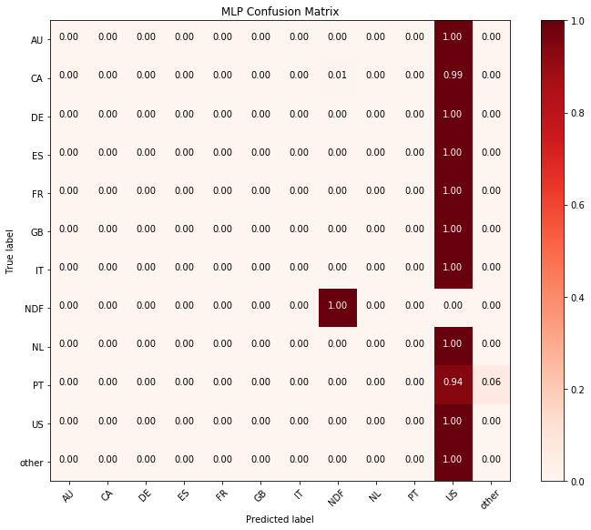
Twelve Category Classification – MLP Classifier
MLP Classifier achieved accuracy of > 88%
But this was achieved by predicting US as the destination for any target other than NDF
Observations between US and other destinations not distinct enough to classify accurately, or not enough data in less popular categories.

Slide 23
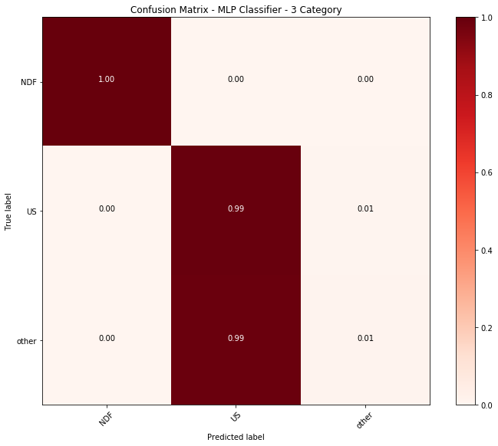
Three Category Classification
Because 92% of the data was contained in three categories (NDF, US, other), reformatted the problem to a three-category classification.
Country destinations other than US and NDF were labeled ‘other’
Similar result to 12-category classification
All destinations that were not NDF were labeled ‘US’

Slide 24
Twelve Category Classification – Balanced Data
Classifier | Score | Avg. Precision | Avg. Recall
MLP | 0.3696 | 0.34 | 0.34
Random Forest | 0.8904 | 0.90 | 0.89
NDF, US, and other comprise 92% of the data
Less popular destinations like Netherlands are only 0.35%
To supply model with additional data for less chosen destinations, created balanced dataset with equal number of observations for each destination
Bootstrapped data (sampling with replacement) to create dataset with an even number of observations for each category.
Random Forest showed improvement with this method, while MLP had large downgrade in accuracy.

Slide 25
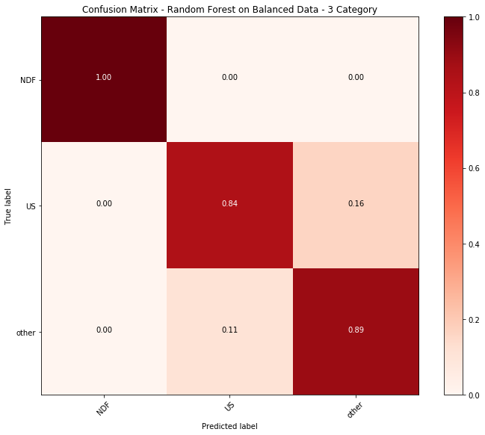
Three Category Classification – Balanced Data
Performing three-category classification on balanced data, model was able to produce much more accurate predictions.

Slide 26
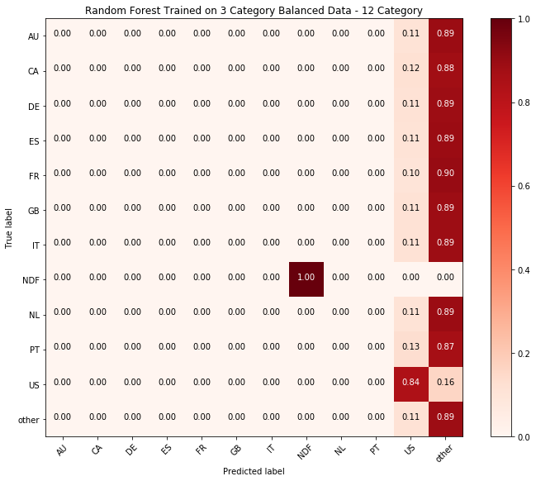
Twelve Category Classification – Balanced Data
When performing 12-category predictions on model trained with 3-category data, very accurate in identifying US and Other destinations.

Slide 27
Classification Analysis - Conclusions
Skewed Data → Skewed Results
Models were able to attain high accuracy, but this was done by predicting only ‘US’ as the destination for observations that were not NDF
Available features not enough to accurately distinguish destinations
Model can easily tell users who booked a trip vs. those who didn’t, but can’t accurately distinguish individual countries.
Additional features may increase model accuracy.
More Data → More Accurate Models
Additional observations in less-popular categories may improve prediction accuracy
This can be observed by the improved accuracy in the models when using balanced data set with even number of observations in each category.

